Slide 1

AWARENESS CAMPAIGN

Slide 2


Table of Contents
About the hackathon
What teams may build
Technologies teams may build/utilize
Evaluation criteria
Relevant timelines
Team dynamics
Prizes
Q & A

Slide 3
About the Hackathon
This hackathon challenges teams to design and develop inclusive digital solutions that support communication in Ghanaian languages.
All solutions must be accessible to persons with disabilities.
The challenge goes beyond building a technically impressive prototype. Contestants should identify a genuine problem, understand the people affected by it, and develop a solution that can be tested, refined and potentially deployed after the competition.

Slide 4
About the Hackathon
01 Solve a real problem Address a clearly defined communication, accessibility or inclusion challenge. | 02 Design with users Show how persons with disabilities or target communities informed the solution. | 03 Use local context Support Ghanaian languages, cultural realities and local infrastructure constraints.
04 Build responsibly Consider privacy, safety, fairness, consent and accessibility from the beginning. | 05 Plan for adoption Demonstrate why people would trust, use and continue using the solution. | 06 Create future value Develop a pathway toward deployment, incubation, research or a Digital Public Good.

Slide 5
What Teams May Build
Opportunity Area | Examples
Communication & Language | Speech-to-text, text-to-speech, voice assistants, local-language translation, live captioning, sign-language support and communication aids.
Education | Accessible learning platforms, AI tutors in Ghanaian languages, reading support, inclusive assessment tools and classroom captioning.
Healthcare | Maternal-health assistants, medication support, rehabilitation tools, accessible telemedicine and speech-therapy applications.
Financial Inclusion | Voice-enabled mobile money, accessible banking, fraud-awareness tools and financial-literacy assistants.
Public Services | Local-language service assistants, emergency reporting, accessible complaint platforms and inclusive e-government interfaces.
Transportation | Navigation support for blind users, accessible public-transport information, voice ticketing and route guidance.
Agriculture | Voice advisory services, weather and market information, crop-disease support and local-language extension tools.
Employment & Enterprise | Inclusive recruitment, accessible workplace tools, AI business mentors and productivity support.
Community & Culture | Accessible event systems, cultural preservation, storytelling tools and community interpretation platforms.

Slide 6
Artificial Intelligence
Machine Learning
Large Language Models
Automatic Speech Recognition
Text-to-speech
Natural Language Processing
Computer Vision
Sign-language Recognition
Optical Character Recognition
Robotics
Internet Of Things
Mobile And Web Applications
Cloud Computing
Edge AI
Technologies Teams May Use

Slide 7
What a Strong Submission Should Demonstrate
Assessment Dimension | What Judges Will Look For
Problem relevance | The problem is clearly explained, significant and supported by evidence or user insight.
Accessibility and inclusion | The solution can be used by the intended users and does not treat accessibility as an afterthought.
Technical quality | The prototype is functional, appropriately engineered and based on suitable technologies.
Local-language and cultural fit | The system reflects Ghanaian languages, communication practices and operating conditions.
Persuasiveness and adoption | The solution is useful, engaging, trustworthy and likely to encourage continued use.
Responsible innovation | The team addresses privacy, consent, data protection, safety, bias and potential misuse.
Feasibility and scalability | The team presents a realistic implementation, deployment and sustainability pathway.
Impact potential | The solution could produce measurable benefits for users, communities or service providers.

Slide 8
Possible Solutions
Robotics
Accessibility and assistive technologies
Financial inclusion
Automatic Speech Recognition (ASR)
Education and literacy
Health and public service
Telecommunications
Agentic AI

Slide 9
A Simple Ideation Process
Identify the user - Choose a specific group and understand the barriers they face.
Define the problem - State the problem in one clear sentence and explain why existing solutions are inadequate.
Validate the need - Speak with potential users, disability organizations, service providers or domain experts.
Design inclusively - Decide how the solution will support different abilities, literacy levels, devices and languages.
Build the minimum viable solution - Develop the smallest functional prototype that demonstrates the core value.
Test and improve - Observe users interacting with the prototype and respond to the problems they encounter.
Plan for sustainability - Explain who will operate, maintain, fund or adopt the solution after the hackathon.
DO NOT START WITH THE TECHNOLOGY. Start with a person, a barrier and a real need. Then select the technology that can solve it effectively.
Notes:
Focus on accessibility: clearly show how your chosen technology (ASR, TTS, computer vision, NLP, or robotics) helps the specific disability group or communication barrier you're addressing.
Make it clear how the solution will work in a specific Ghanaian language, rather than discussing the technology in general terms.
Specify a product idea: define a realistic, hackathon-friendly project.
Clearly specify the form factor (e.g., mobile app, desktop application, wearable device, USSD interface).
Include a brief mention of the user experience — how a user will input and receive responses.
If your track is business, show how the solution reaches real users sustainably—including, where relevant, financial inclusion for persons with disabilities.

Slide 10
Evaluation Criteria
Suitability
Core technology implementation: is the chosen technology (ASR, TTS, computer vision, NLP, or robotics etc) effectively integrated for the target users?
Inclusive design: to what extent does the solution prioritize usability and accessibility for people with disabilities, individuals with low digital literacy, and those in underserved communities?
Feasibility: how practical and achievable is the proposed solution within the constraints of time, available resources, and the real-world context of user access?

Slide 11
Evaluation Criteria
Originality / Innovation
How novel is the idea, and to what extent does it offer a creative approach to assistive technology and inclusion in Ghanaian languages?
Does the solution address a clearly identified need within the Ghanaian or broader African context, particularly around communication, accessibility, or inclusion — including financial inclusion for persons with disabilities?
4

Slide 12
Evaluation Criteria
C. User Experience (UX)
Does the solution offer an intuitive, easy-to-use interface tailored to the needs of its target users?
To what extent is it adaptable and inclusive beyond one disability group — addressing broader accessibility needs where possible?
D. Scalability
Does the solution demonstrate potential for growth and adaptability across different regions, languages, or user groups beyond its initial target audience?
4

Slide 13
Evaluation Criteria
E. Presentation quality
Does it effectively communicate the solution, its value, and its potential impact to the target audience.
F. Market Readiness
4

Slide 14
Relevant Timelines
Pre-Hackathon Phase (Virtual)
Jul 20 – Aug 10, 2026: Registration
Aug 3 – 10, 2026: Awareness campaign and team outreach
Aug 10, 2026: Applications close | Aug 14, 2026: Selected teams notified
Aug 11 – 31, 2026: Online bootcamp
Sep 1 – Oct 23, 2026: Ideation sprint with mentor reviews
7

Slide 15
Relevant Timelines
Hackathon Phase – In Person
Oct 26 – 29, 2026: In-person mentoring and Student Innovation Fair
Oct 30, 2026: Grand finale – keynote sessions, final pitch, demo presentations, and awards
Post-Hackathon
Nov 1 – Dec 10, 2026: Feedback and follow-up, incubation support, and pathways to industry pilots

Slide 16
Team Dynamics
Teams may have up to five members, with at least one female member.
As part of our commitment to accessibility and inclusion, teams should preferably include at least one person with a disability.

Slide 17

Prizes
1ST PRIZE
GH₵70,000
2ND PRIZE
GH₵20,000
3RD PRIZE
GH₵10,000
6

Slide 18
Special award categories:
Best Agentic AI Solution
Best Financial Inclusion Solution
Best Digital Experience Innovation
Best Female-Led Team
6

Slide 19
Questions and Answers
1. What languages can teams work with this year?
Unlike 2025 (Akan only), the 2026 edition expands to multiple Ghanaian languages.
2. Can teams work on solutions beyond speech impairment?
Yes. 2026 broadens the scope to additional disability groups and a wider range of inclusive digital solutions, while keeping accessibility as a requirement for every submission.

Slide 20
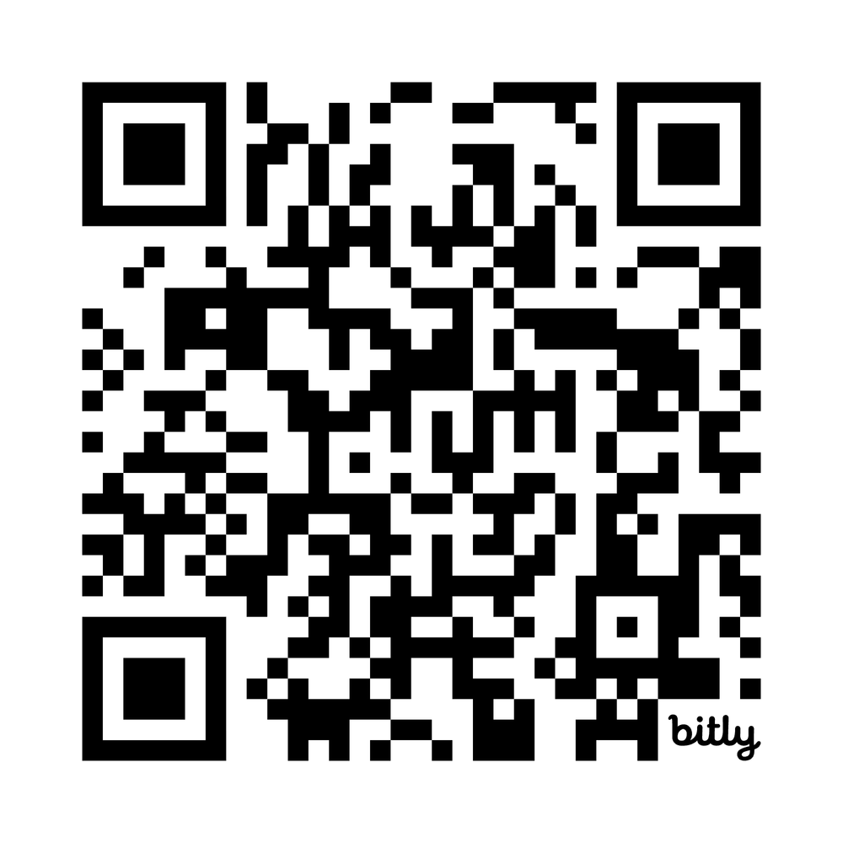
Registration QR Code
5

Slide 21
For enquiries:
WEBSITE
www.tekyeremapahackathon.com
EMAIL
dcshcilab@ug.edu.gh
SOCIAL MEDIA
https://linktr.ee/DCSHCILAB

Slide 22
The End

